Slide 1

UNIVERSITY INSTITUTE OF ENGINEERING
COMPUTER SCIENCE ENGINEERING
Bachelor of Engineering (Computer Science & Engineering)
Subject Name: Block chain Technology
Subject Code: 20_CST-412
Hashing Functions
Mapped with CO4
Prepared By:
Er. Ankita Sharma
DISCOVER . LEARN . EMPOWER

Slide 2
Introduction
A hash function is a mathematical function that converts a numerical input value into another compressed numerical value.
The input to the hash function is of arbitrary length but output is always of fixed length.
Values returned by a hash function are called message digest or simply hash values.
In general, the hash is much smaller than the input data, hence hash functions are sometimes called compression functions.
Since a hash is a smaller representation of a larger data, it is also referred to as a digest.
Hash function with n bit output is referred to as an n-bit hash function. Popular hash functions generate values between 160 and 512 bits.

Slide 3
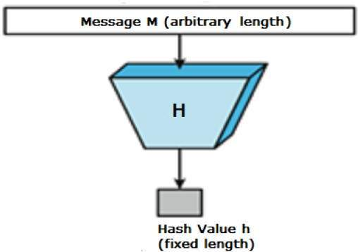

Slide 4
Hash function protects the integrity of the message. If encryption process is applied on message with hash function, it also provide authentication and confidentiality.

Slide 5
Features of Hash Functions
The typical features of hash functions are −
Fixed Length Output (Hash Value)
Hash function converts data of arbitrary length to a fixed length.
Efficiency of Operation
Generally for any hash function h with input x, computation of h(x) is a fast operation.
Computationally hash functions are much faster than a symmetric encryption.
Pre-Image Resistance
This property means that it should be computationally hard to reverse a hash function.
In other words, if a hash function h produced a hash value z, then it should be a difficult process to find any input value x that hashes to z.
This property protects against an attacker who only has a hash value and is trying to find the input.

Slide 6
Features continued…
Second Pre-Image Resistance
This property means given an input and its hash, it should be hard to find a different input with the same hash.
In other words, if a hash function h for an input x produces hash value h(x), then it should be difficult to find any other input value y such that h(y) = h(x).
This property of hash function protects against an attacker who has an input value and its hash, and wants to substitute different value as legitimate value in place of original input value.

Slide 7
Features continued…
Collision Resistance
This property means it should be hard to find two different inputs of any length that result in the same hash.
In other words, for a hash function h, it is hard to find any two different inputs x and y such that h(x) = h(y).
This property makes it very difficult for an attacker to find two input values with the same hash.
Also, if a hash function is collision-resistant then it is second pre-image resistant.

Slide 8
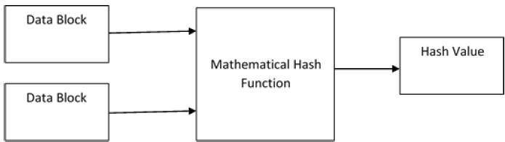
Design of Hashing Algorithms
At the heart of a hashing is a mathematical function that operates on two fixed-size blocks of data to create a hash code. This hash function forms the part of the hashing algorithm.
Hashing algorithm involves rounds of above hash function like a block cipher.
Each round takes an input of a fixed size, typically a combination of the most recent message block and the output of the last round.

Slide 9
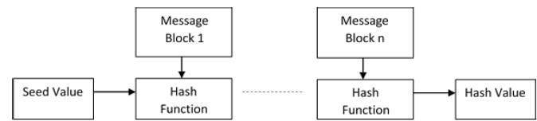
Since, the hash value of first message block becomes an input to the second hash operation, output of which alters the result of the third operation, and so on.
This effect, known as an avalanche effect of hashing.
Schematic diagram of hashing function

Slide 10
Application
These are some of the most common cryptographic applications:
Password Verification
Storing passwords in a regular text file is dangerous, so nearly all sites store passwords as hashes.
When a user inputs their password, it is hashed and the result is compared to the list of hashed values stored on the company's servers.

Slide 11
Signature Generation and Verification
Verifying signatures is a mathematical process used to verify the authenticity of digital documents or messages.
A valid digital signature, where the prerequisites are satisfied, gives its receiver strong proof that the message was created by a known sender and that the message was not altered in transit.
A digital signature scheme typically consists of three algorithms: a key generation algorithm; a signing algorithm that, given a message and a private key, produces a signature; and a signature verifying algorithm.
Merkle Trees, a technology used in cryptocurrencies, is a kind of digital signature.

Slide 12
Verifying File and Message Integrity
Hashes can be used to make sure messages and files transmitted from sender to receiver are not tampered with during transit.
The practice builds a "chain of trust."
For example, a user might publish a hashed version of their data and the key so that recipients can compare the hash value they compute to the published value to make sure they align.

Slide 13
Popular Hash Functions
Message Digest (MD)
MD5 was most popular and widely used hash function for quite some years.
The MD family comprises of hash functions MD2, MD4, MD5 and MD6. It was adopted as Internet Standard RFC 1321. It is a 128-bit hash function.
MD5 digests have been widely used in the software world to provide assurance about integrity of transferred file. For example, file servers often provide a pre-computed MD5 checksum for the files, so that a user can compare the checksum of the downloaded file to it.
In 2004, collisions were found in MD5. An analytical attack was reported to be successful only in an hour by using computer cluster. This collision attack resulted in compromised MD5 and hence it is no longer recommended for use.

Slide 14
Secure Hash Function (SHA)
Family of SHA comprise of four SHA algorithms; SHA-0, SHA-1, SHA-2, and SHA-3.
It is employed in several widely used applications and protocols including Secure Socket Layer (SSL) security.
In 2005, a method was found for uncovering collisions for SHA-1 within practical time frame making long-term employability of SHA-1 doubtful.
SHA-2 family has four further SHA variants, SHA-224, SHA-256, SHA-384, and SHA-512 depending up on number of bits in their hash value.
No successful attacks have yet been reported on SHA-2 hash function.

Slide 15
Applications of Hash Functions
Password Storage
An intruder can only see the hashes of passwords, even if he accessed the password. He can neither logon using hash nor can he derive the password from hash value since hash function possesses the property of pre-image resistance.
Data Integrity Check
Data integrity check is a most common application of the hash functions. It is used to generate the checksums on data files. This application provides assurance to the user about correctness of the data.

